Slide 1
Vaccine Distribution Optimization
Preparing for the next pandemic -
[DSKUS Group6]
Carolyn Haythorn
Sneha Satish
Haneul Kim
YeEun Jeon
Notes:
yeeun

Slide 2
Given Topic: Mitigating disruptions in the global supply chain caused by the continued COVID-19 pandemic
Notes:
y

Slide 3
Given Topic: Mitigating disruptions in the global supply chain caused by the continued COVID-19 pandemic
Project Topic: How can we optimize vaccine distribution
if another pandemic happens?
Notes:
y

Slide 4
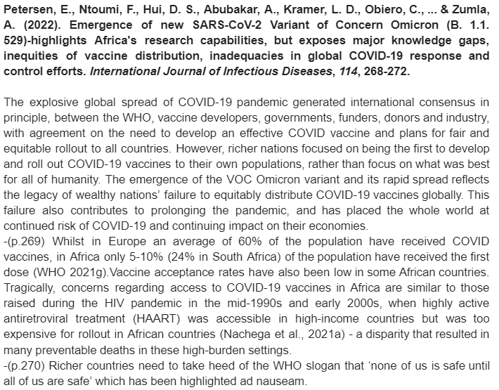
Vaccine Distribution in COVID-19 and future
* Richer nations focused on rolling out vaccines to their own populations
*Vaccination rate low in African countries
Unequal vaccine distribution led to emergence of omicron variant
How can vaccination rates be more equitable in a future pandemic?
Notes:
yeeun

Slide 5
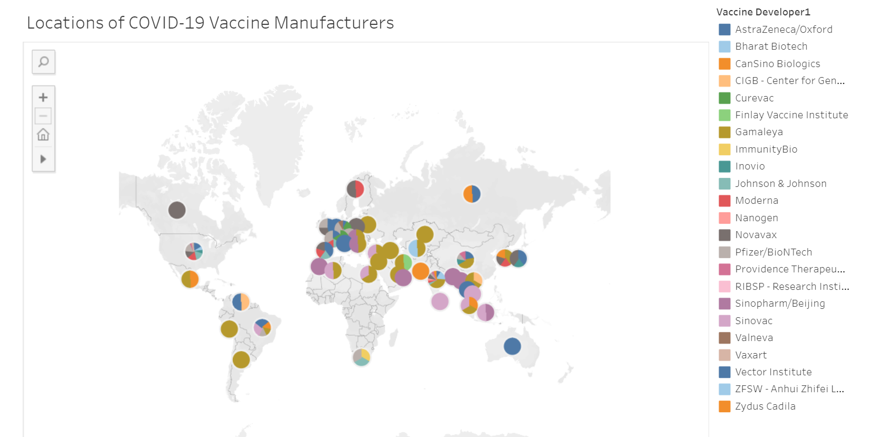
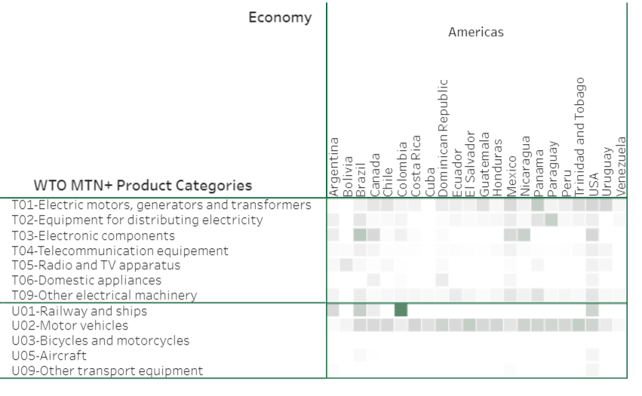
Data collection
Country-wise Population - The World Bank
Vaccine Manufacturers - Geneva Graduate Institute Global Health Centre
Country relationship - CEPII
Trade Data - World Trade Organization
Notes:
h population: https://data.worldbank.org/indicator/SP.POP.TOTL
distance: http://www.cepii.fr/CEPII/en/bdd_modele/bdd_modele_item.asp?id=6
For data collections we basically used 4 data. Population , Vaccine manufacturers, country relationship and trade data. In the case of vaccine manufacturing data, there were too many empty data to analyze, so Kaggle data was also imported and combined. We merged the data to see trade and country-by-country relationships.

Slide 6
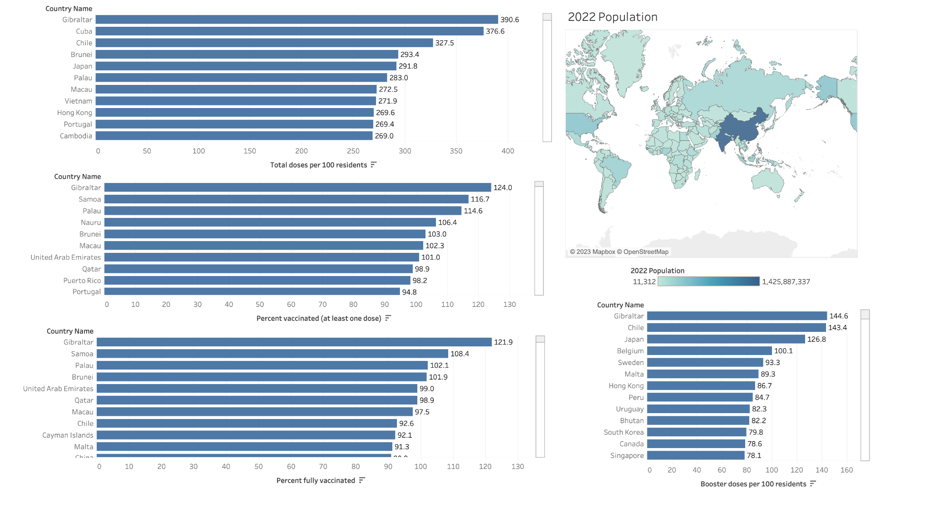
EDA - Census Data
Notes:
s

Slide 7
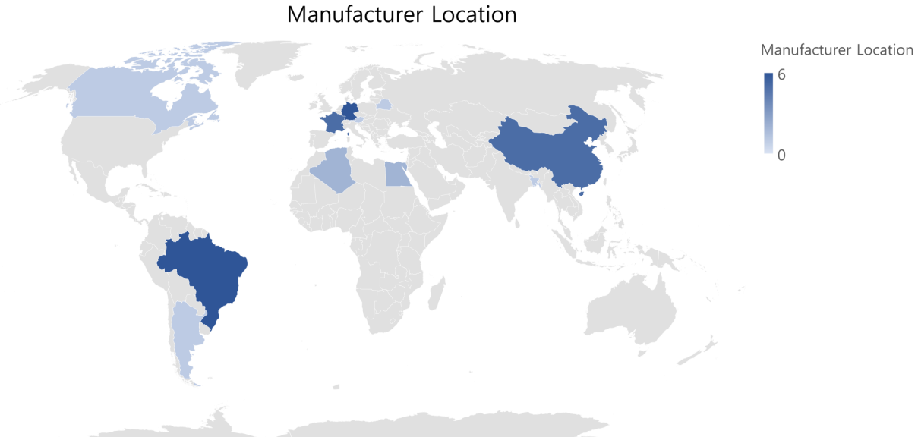
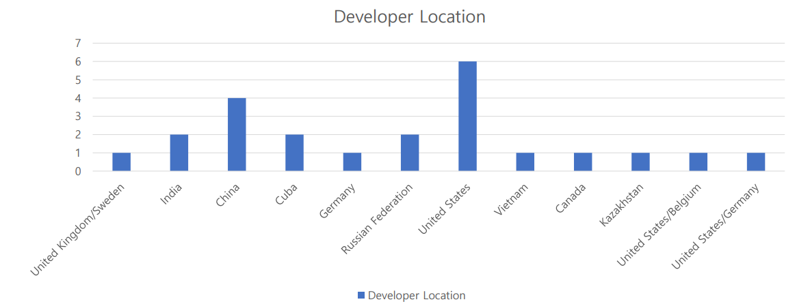
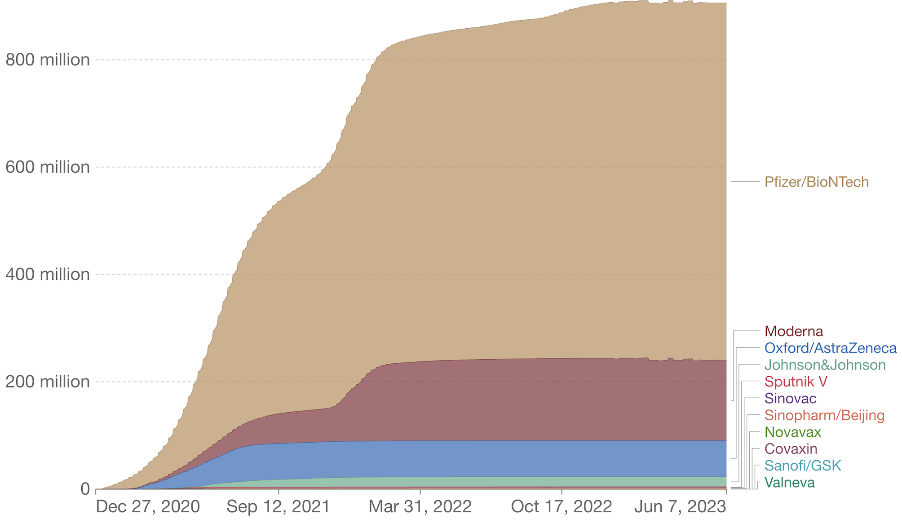
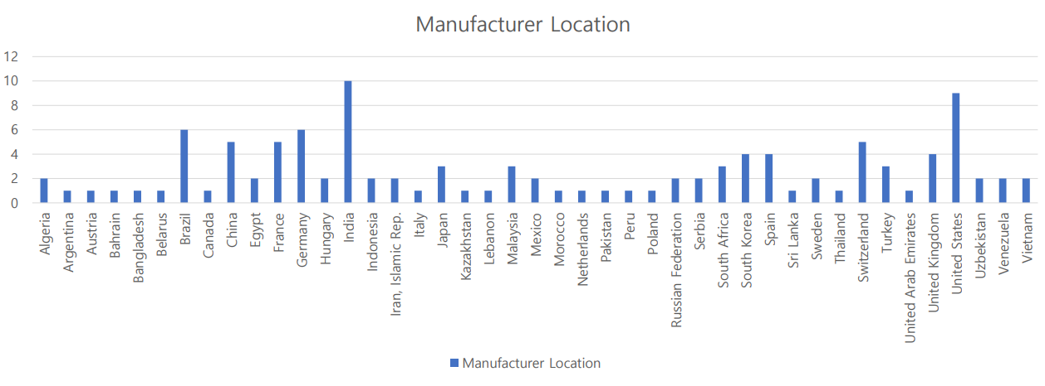
EDA - Vaccine Data
Notes:
For the Vaccine data EDA. I used manufacturing data to see which countries did the most development and manufacturing. As you can see, the United States developed and manufactured the most, and it was found that developing and developing countries also produced a lot of vaccines.

Slide 8
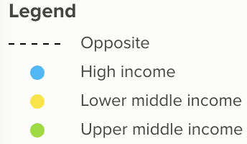
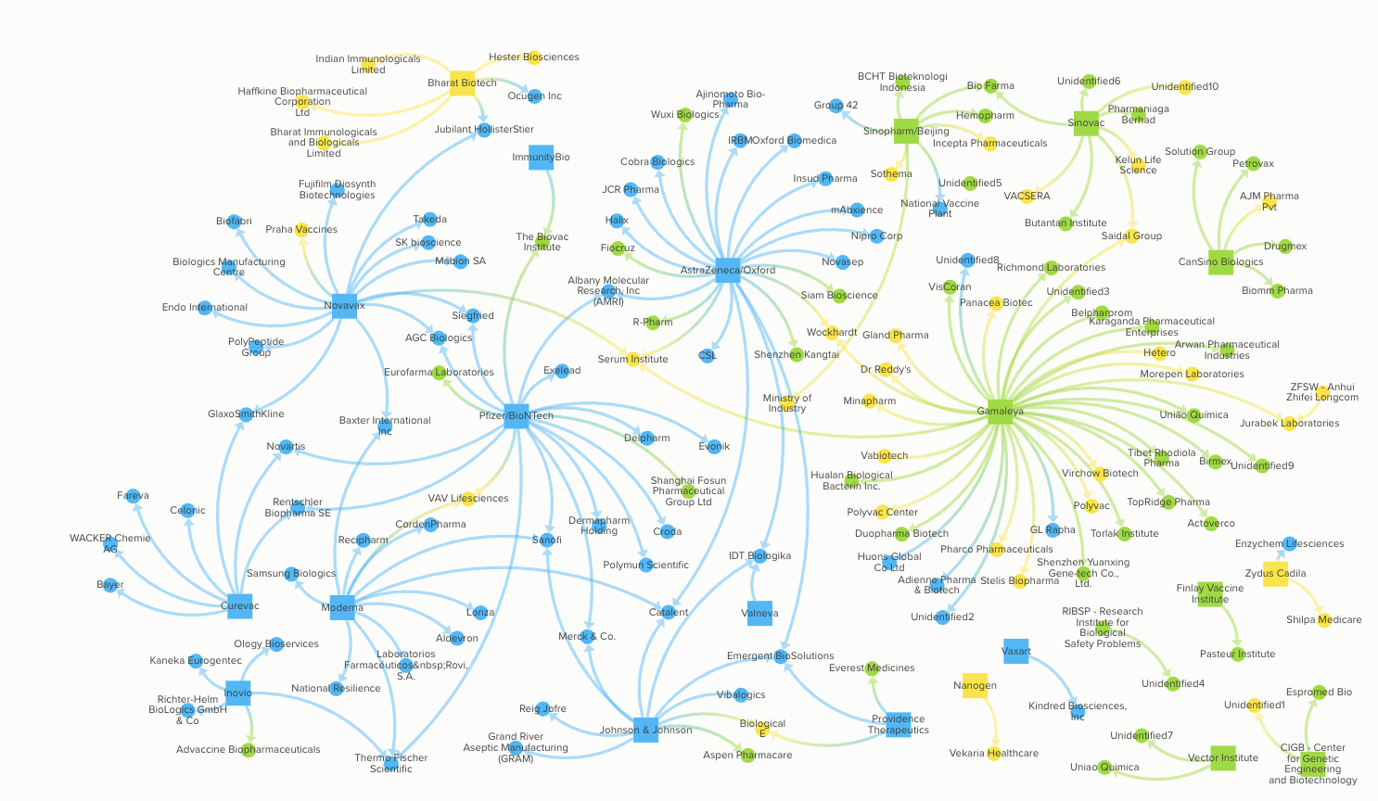
EDA - Vaccine Data
Notes:
Vaccine developers based in high-income countries have primarily selected manufacturing partners also based in high income countries (79%, 77/97) . In contrast, vaccine developers from middle income countries (China, Cuba, India, Kazakhstan, Russia and Vietnam) have primarily selected manufacturing partners based in middle income countries ( 86%, 63/73; 42% lower-middle, 44% upper-middle). There are no arrangements in our dataset with manufacturers based in low-income countries.

Slide 9
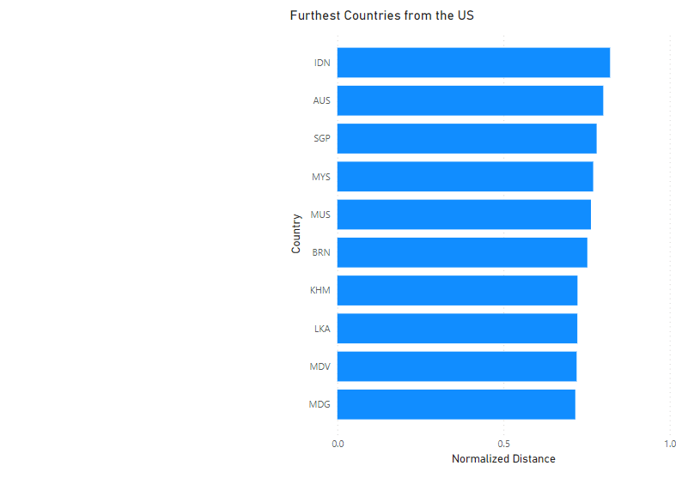
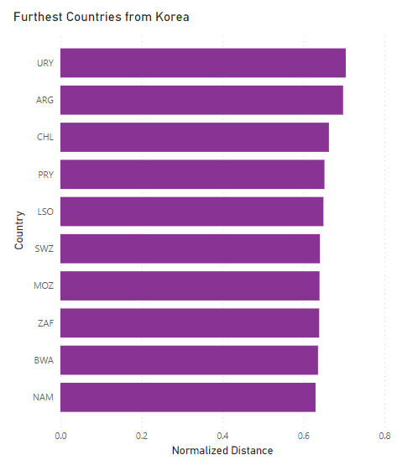
EDA - Country Distances
Notes:
C

Slide 10
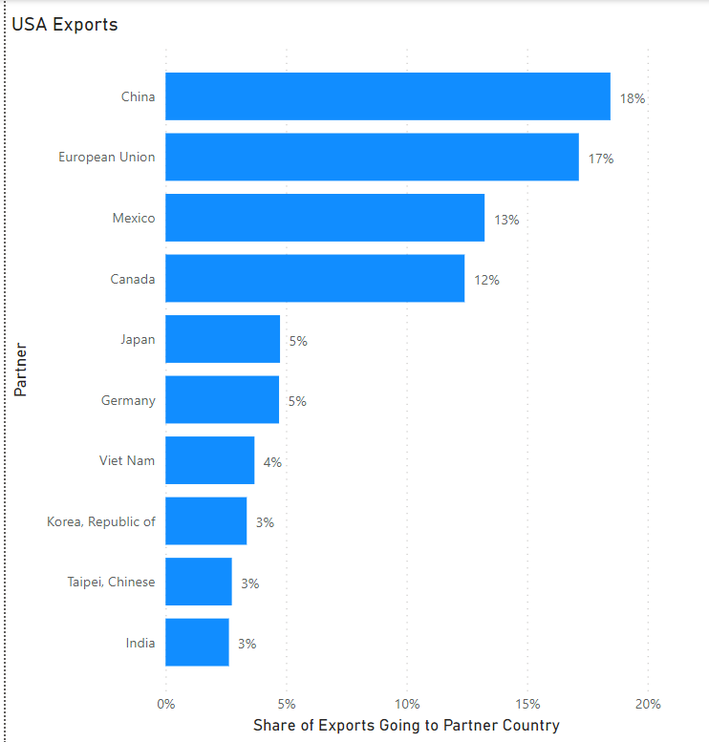
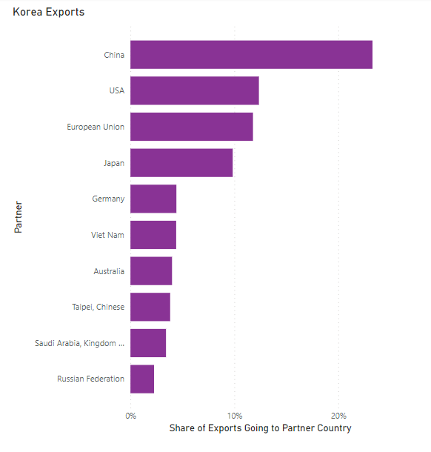
EDA -Trade data
Notes:
C

Slide 11
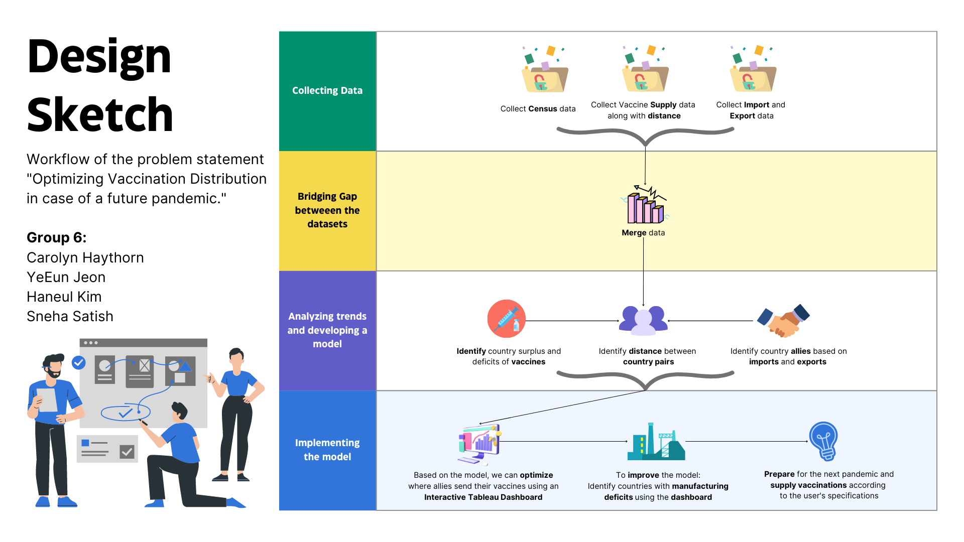
Notes:
s

Slide 12
Cleaning the Dataset
Utilized standard 3-letter country codes to merge datasets
Addressed missing data – assumed “worst case” for missing data
Normalized country distance and trade data
Calculated vaccine surplus or deficit using census data and vaccine supply data
Notes:
c

Slide 13
Country Ally Score: Trade and Proximity
Trade indicator = portion of the supplier’s exports which go to the receiver country + portion of the receivers imports which come from the supplier country
Prioritizes countries that “specialize” in exporting / importing from specific others
Utilized both exports and imports to account for different economy sizes
Distance indicator = the distance between two countries
Utilized pre-existing dataset
Notes:
c

Slide 14
Optimizing Vaccine Distribution
For each country with a vaccine deficit:
Identify viable supply countries - must be able to supply all vaccines
Of the viable supply partners, identify the country with pair with the highest score
Subtract the vaccine deficit from the supply country’s surplus
Shuffle remaining surplus countries
Iterate until all countries with deficits have a partner
Notes:
c

Slide 15
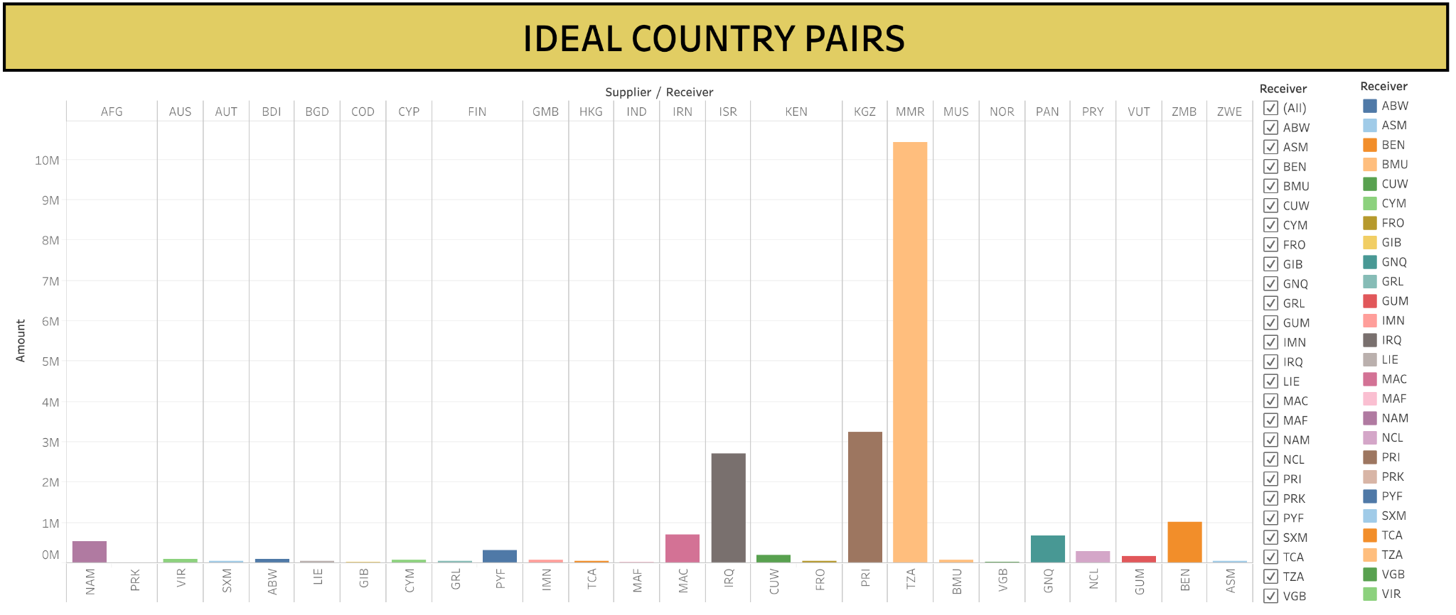
INTERACTIVE DASHBOARD
Link: https://public.tableau.com/shared/TRK84M74P?:display_count=n&:origin=viz_share_link
Notes:
s

Slide 16
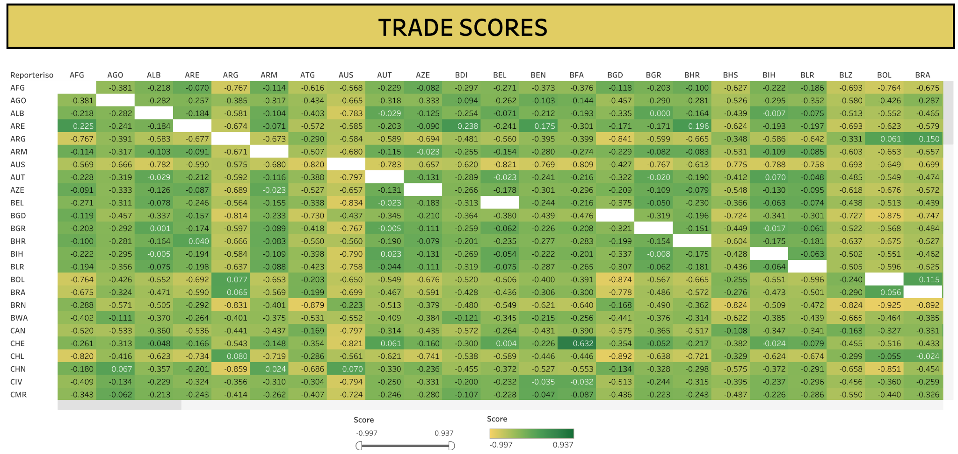
Notes:
s

Slide 17
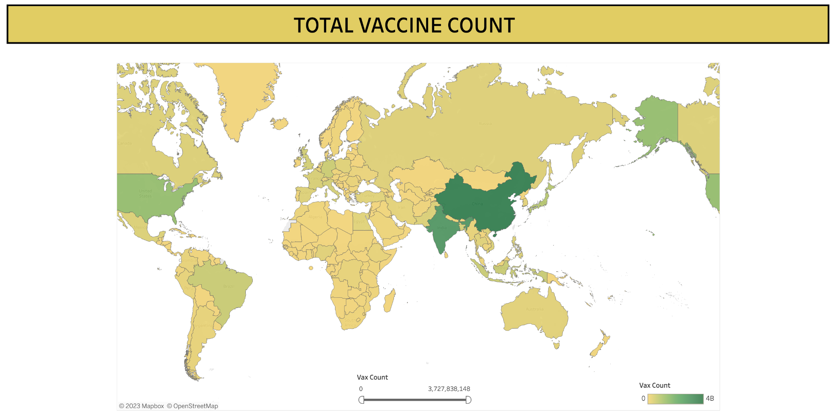

Slide 18
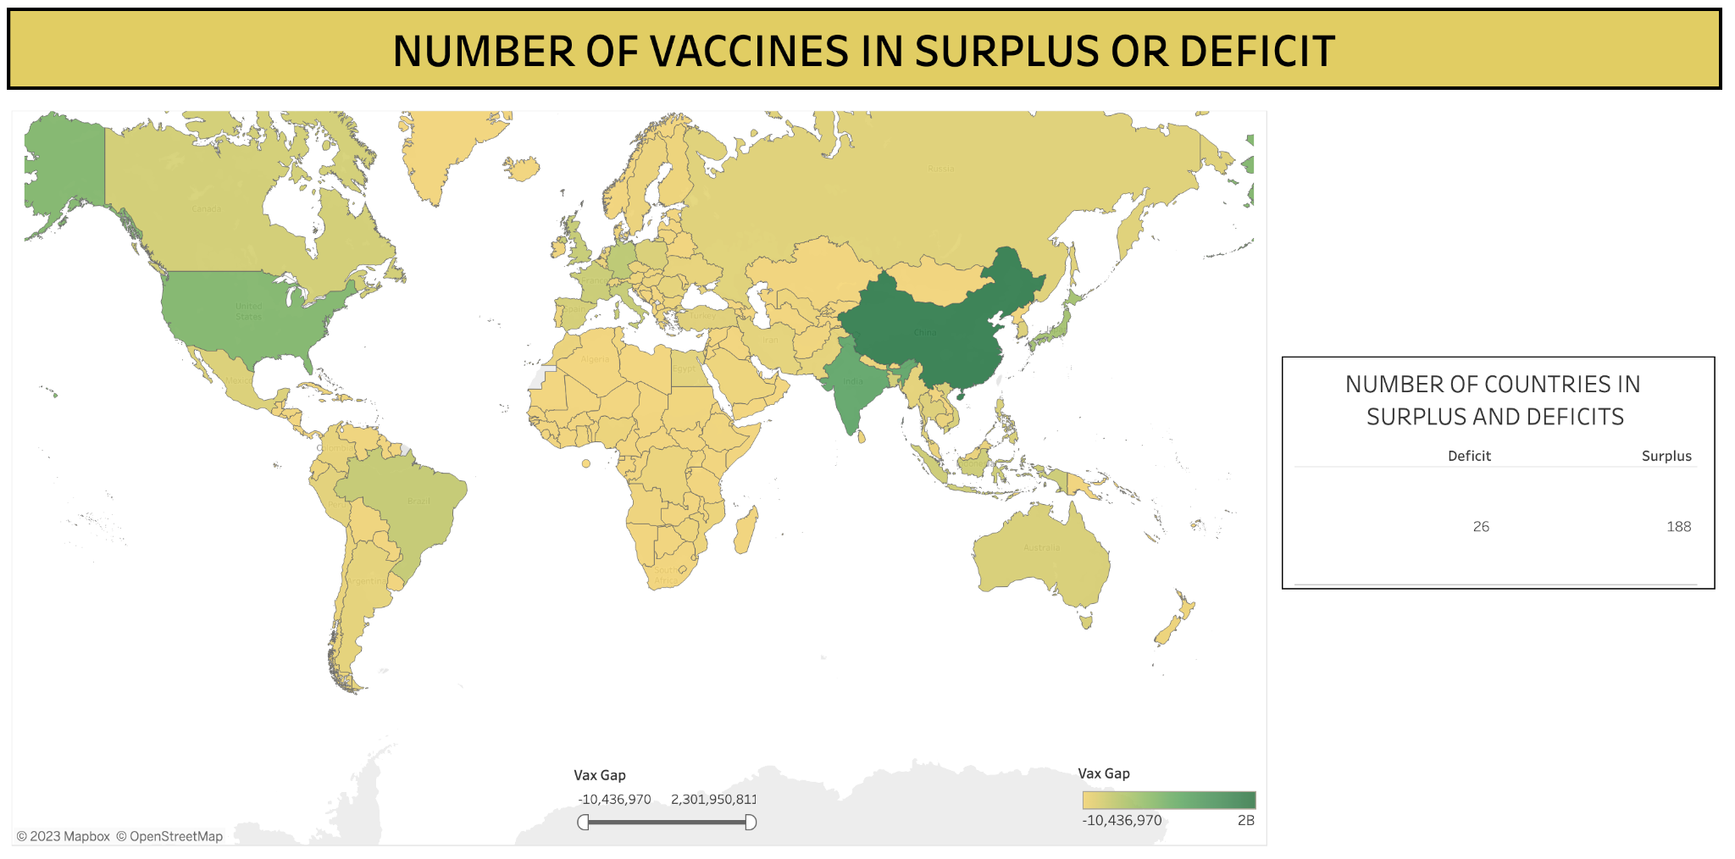
Notes:
s

Slide 19
Conclusion
The COVID-19 pandemic demonstrated that unequal distribution of vaccines prolonged the pandemic and cost lives
Data infrastructure developed during the pandemic supports future global health; these systems should be maintained
Optimization algorithms can make difficult decisions more straight-forward
Combining trade and distance data supports efficient vaccine shipment
By fine-tuning the model now, the world will be ready for future pandemics
Notes:
s

Slide 20
Limitations
When building algorithm, there are some features that we couldn’t consider due to lack of available data (e.g., political relationships between countries)
Developing countries may have difficulties collecting vaccination data, so they may find it difficult to periodically update vaccination rates.
Maintaining data collection procedures developed during the COVID-19 pandemic will be important
Built algorithm using current data, when vaccine shortages are not as prevalent
Only countries that can completely fill a vaccine gap are viable partners.
Notes:
y

Slide 21
Future Analysis
Additional complexity can be added to adjust for vaccination shortages or prioritize countries with more at-risk populations
Vaccine manufacturing data and pharmaceutical exports can be added to model to predict future vaccine supply.
Weighted graphs can be utilized to partially address deficits
Recommend to policy makers where to strengthen trade ties
Suggest manufacture of vaccine manufacturing units as per deficits
Notes:
c

